Slide 1
Training on Java Programming
Instructor: @Subash @Paudyal

Slide 2
Session 12: Java Input Output
What are streams?
Java IO Streams
Byte Oriented Streams
Character Oriented Streams
Byte Stream Classes
FileInputStream, FileOutputStream
BufferedInputStream, BufferedOutputStream
DataInputStream, DataOutputStream
PrintStream
Character Stream Classes
FileReader, FileWriter
BufferedReader, BufferedWriter
RandomAccessFile
Files
Directories

Slide 3
Objective
Quickly and easily write programs that accomplish many common IO tasks :
Reading and writing files
Communicating over network connections
Filtering data
Interpreting a wide variety of formats for integer and floating-point numbers
Encrypting and decrypting data
Calculating digital signatures for streams
Compressing and decompressing data
Writing objects to streams
Copying, moving, renaming, and getting information about files and directories
Letting users choose files from a GUI interface
Reading and writing non-English text in a variety of character sets
Formatting integer and floating-point numbers as strings
Talking directly to modems and other serial port devices

Slide 4
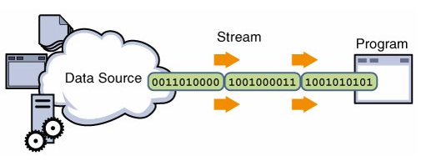
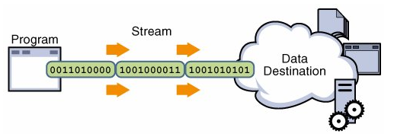
Streams
A stream is an ordered sequence of bytes of undetermined length.
Input streams move bytes of data into a Java program from some generally external source. Like, like a siphon that sucks up water
Output streams move bytes of data from Java to some generally external target. Like, A hose that sprays out water
A stream can represent many different kinds of sources and destinations, including disk files, devices, network sockets other programs, and memory arrays
Streams support many different kinds of data, including simple bytes, primitive data types, to advanced objects
Provides interface to external world

Slide 5
What to read and write?
Input streams read bytes and output streams write bytes.
Readers read characters and writers write characters.
Therefore, to understand input and output, you first need a solid understanding of how Java deals with bytes, integers, characters, and other primitive data
Integers: byte (8 bit) , Short (16 bits), Int (32 bits), Long (64 bits)
Java support only int literal, no byte and short are available
byte b=42 and short s=24000; //compiler does conversion here
Byte b1=5, b2=7; Byte b3=b1+b2; is also error as when bytes are added it gives integer output and that can’t be assigned to byte

Slide 6
Data IO in java
Standard output (to Screen/Console)
System.out
System.out.println(“Hello”);
System.err
System.err.println(“Stop”);
Standard input (from keyboard)
System.in
System.in.read();
Java io files are available in package java.io.*;
Java’s stream-based I/O is based on four abstract classes:
Byte Streams (InputStream, OutputStream) – used when working with bytes or other binary objects
Character Streams (Reader, and Writer) – used when working with characters or strings

Slide 7
Input and Output Byte Streams
Programs use byte streams to perform input and output of 8-bit bytes.
The byte stream classes provide a rich environment for handling byte-oriented I/O.
A byte stream can be used with any type of object, including binary data. This versatility makes byte streams important to many types of programs.
All byte stream classes are descended from InputStream and OutputStream
Every things is read as byte form (signed integer that ranges from -128 to 127)
Java stream classes accept and return int which are internally converted to byte

Slide 8
InputStream
InputStream is an abstract class that defines Java’s model of streaming byte input
Most of the methods in this class will throw an IOException when an I/O error occurs
We use the derived classes to perform input functions. Some functions are:
read() read a byte from input stream
read(byte[] b) read a byte array from input into b
read(byte[]b, int n, int m) read m bytes into b from nth byte
available() gives number of bytes in input
skip(n) skips n bytes from input stream
reset() goes back to beginning of stream
close() closes the input stream
Read() method returns actual number of bytes that were successfully read or-1 if end of the file is reached.

Slide 9
OutputStream
OutputStream is an abstract class that defines streaming byte output.
Most of the methods in this class return void and throw an IOException in the case of I/O errors.
OutputStream has following methods:
write() write a byte to output stream
write(byte[] b) write all bytes in b into output stream
write(byte[] b, int n, int m) write m bytes from array b from n’th
close() Closes the output stream
flush() flushes the output stream

Slide 10
Input Streams and Output Streams
OutputStream
ByteArray
OutputStream
FileOutput
Stream
FilterOutput
Stream
PipedOutput
Stream
Buffered
OutputStream
PrintStream
DataOutput
Stream
The hierarchy of input streams follows similar lines as output streams.
System.in is an instance of InputStream.
System.out and System.err are instances of PrintStream.

Slide 11
FileInputStream
FileInputStream class creates an InputStream that you can use to read bytes from a file.
Constructors:
FileInputStream(String filePath)
FileInputStream(File fileObj)
Code
FileInputStream f0 = new FileInputStream("/autoexec.bat")
File f = new File("/autoexec.bat");
FileInputStream f1 = new FileInputStream(f);

Slide 12
FileOutputStream
FileOutputStream creates an OutputStream that you can use to write bytes to a file.
Constructors:
FileOutputStream(String filePath)
FileOutputStream(File fileObj)
FileOutputStream(String filePath, boolean append)
FileOutputStream(File fileObj, boolean append)

Slide 13
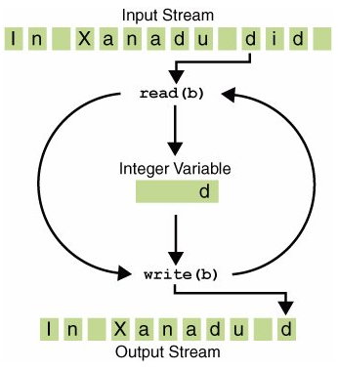
FileInputStream in = null;
FileOutputStream out = null;
try {
in = new FileInputStream(“file1.txt");
out = new FileOutputStream(“file2.txt");
int c;
while ((c = in.read()) != -1) {
out.write(c); }
}
finally {
if (in != null) {
in.close(); }
if (out != null) {
out.close(); }
}

Slide 14
Filtered Streams
Filtered streams are simply wrappers around underlying input or output streams that transparently provide some extended level of functionality.
These streams are typically accessed by methods that are expecting a generic stream
The filtered byte streams are
FilterInputStream and
FilterOutputStream
The methods provided in these classes are identical to those in InputStream and OutputStream.
We deal with the classes derived from Filtered Streams
Buffered Streams
Print Streams
Data Streams

Slide 15
Buffered Streams
The java.io.DataInputStream and java.io.DataOutputStream classes are subclasses of FilterInputStream and FilterOutputStream , respectively.
For the byte-oriented streams, a buffered stream extends a filtered stream class by attaching a memory buffer to the I/O stream.
This buffer allows Java to do I/O operations on more than a byte at a time, thereby improving performance.
The buffered byte stream classes are BufferedInputStream and BufferedOutputStream.
class allows you to "wrap" any InputStream into a buffered stream to improve performance
Constructors:
BufferedInputStream(InputStream inputStream)
BufferedInputStream(InputStream inputStream, int bufSize)

Slide 16
PrintStream
The PrintStream class provides all of the output capabilities we have been using from the System file handle, System.out,
Constructors
PrintStream(OutputStream outputStream)
PrintStream(OutputStream outputStream, boolean flushOnNewline)
PrintStream(OutputStream outputStream, boolean flushOnNewline, String charSet)
PrintStream supports the print( ) and println( ) methods for all types, including Object. If an argument is not a primitive type, the PrintStream methods will call the object’s toString( ) method and then display the result.
After JDK5, printf() method was added that allows to specify the precise format of the data to be written
PrintStream printf(String fmtString, Object … args)

Slide 17
DataOutput and DataInput
Data streams support binary I/O of primitive data type values (boolean, char, byte, short, int, long, float, and double) as well as String values.
DataOutput defines methods that convert values of a primitive type into a byte sequence and then writes it to the underlying stream.
Constructor
DataInputStream dis = new DataInputStream(new FileInputStream("data.txt"));
DataOutputStream dos = new DataOutputStream(new FileOutputStream("output.dat"));
DataInputStream is the complement of DataOuputStream and the methods are also equivalent such as readDouble()

Slide 18
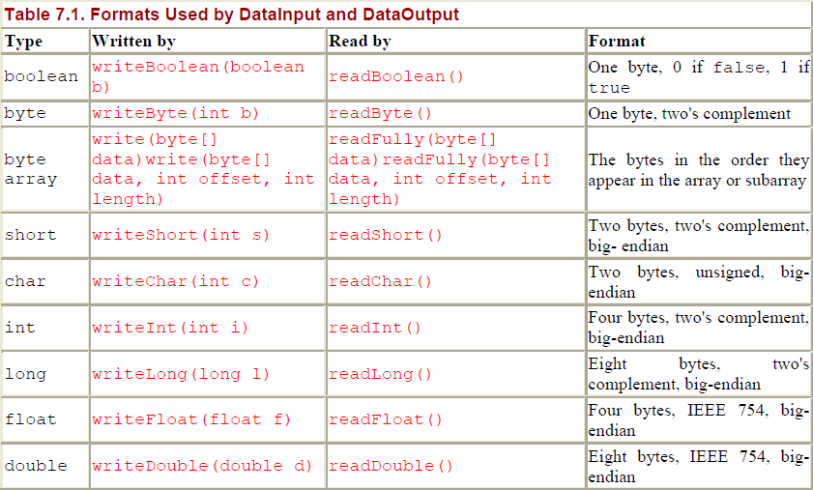
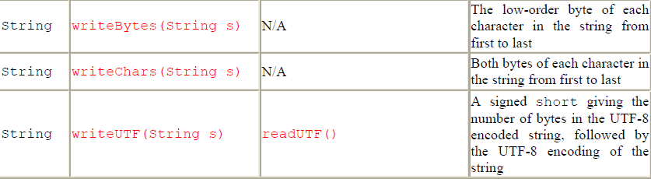

Slide 19
UTF Format
the only reliable way to write a String so that it can be recovered by a DataInputStream is to use UTF-8 encoding, accomplished in this example using writeUTF( ) and readUTF( )
UTF-8 is a multi-byte format, and the length of encoding varies according to the actual character set in use.
Unicode is a tremendous waste of space and/or bandwidth, so UTF-8 encodes ASCII characters in a single byte, and non-ASCII characters in two or three bytes.
out.writeUTF("Square root of 2");
System.out.println(in.readUTF());

Slide 20
//First, write the data
DataOutputStream dout =
new DataOutputStream(new FileOutputStream("Test.dat"));
try {
dout.writeDouble(98.6);
dout.writeInt(1000);
dout.writeBoolean(true);
} catch(FileNotFoundException e) {
System.out.println("Cannot Open Output File");
return;
} catch(IOException e) {
System.out.println("I/O Error: " + e);
}
// Now, read the data back.
DataInputStream din =
new DataInputStream(new FileInputStream("Test.dat"));
try{
double d = din.readDouble();
int i = din.readInt();
boolean b = din.readBoolean();
System.out.println("Here are the values: " +
d + " " + i + " " + b);
} catch(FileNotFoundException e) {
System.out.println("Cannot Open Input File");
return;
} catch(IOException e) {
System.out.println("I/O Error: " + e);
}

Slide 21
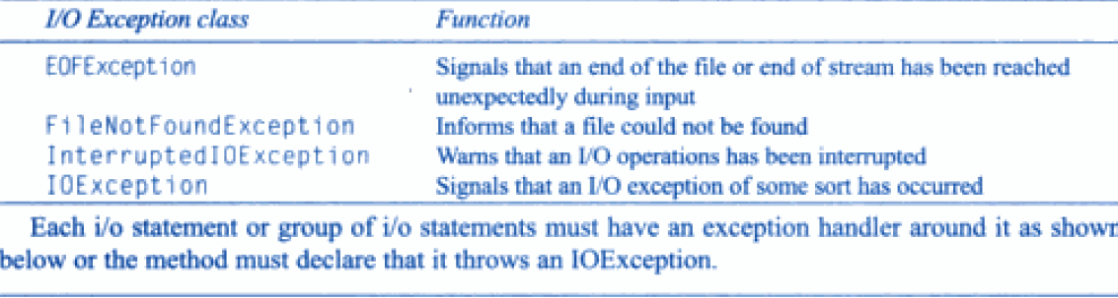
Exceptions in IO

Slide 22
When Not to Use Byte Streams
Bytes copy seems like a normal program, but it actually represents a kind of low-level I/O that you should avoid.
Since abc.txt contains character data, the best approach is to use character streams, as discussed in the next section.
There are also streams for more complicated data types. Byte streams should only be used for the most primitive I/O.
So why we learn about byte streams?
Because all other stream types are built on byte streams

Slide 23
Character Streams
Readers and writers are based on characters, which can have varying widths depending on the character set.
ASCII and ISO Latin-1 use one-byte characters. Unicode uses two-byte characters
Since characters are ultimately composed of bytes, readers take their input from streams.
However, they convert those bytes into chars according to a specified encoding format before passing them along.
Similarly, writers convert chars to bytes according to a specified encoding before writing them onto some underlying stream.
I/O with character streams is no more complicated than I/O with byte streams.
All character stream classes are descended from Reader and Writer.
The most important reason for the Reader and Writer hierarchies is for internationalization.

Slide 24
FileReader and FileWriter
The FileReader class creates a Reader that you can use to read the contents of a file.
Reading from file
FileReader(String filePath)
FileReader(File fileObj)
Writing to File
FileWriter(String fileName)
FileWriter(String fileName, boolean append)
If append is true, then the file is appended not overwritten

Slide 25
FileReader inputStream = null;
FileWriter outputStream = null;
try {
inputStream = new FileReader(“file1.txt");
outputStream = new FileWriter(“file2.txt");
int c;
while ((c = inputStream.read()) != -1) {
outputStream.write(c); }
}
finally {
if (inputStream != null) {
inputStream.close(); }
if (outputStream != null) {
outputStream.close(); }
}
Note: In, Character Copy the int variable holds a character value in its last 16 bits; In Bytes Copy, the int variable holds a byte value in its last 8 bits.

Slide 26
Buffered Reader and Writer
BufferedReader inputStream = null;
PrintWriter outputStream = null;
try {
inputStream = new BufferedReader(new FileReader("xanadu.txt"));
outputStream = new PrintWriter(new FileWriter("characteroutput.txt"));
String l;
while ((l = inputStream.readLine()) != null) {
outputStream.println(l); }
}
finally {
if (inputStream != null) {
inputStream.close(); }
if (outputStream != null) {
outputStream.close(); }
}
We can wrap the FileWriter object to the Buffered Writer to achieve higher performance
Eg. PrintWriter outputStream = new PrintWriter(new BufferedWriter(new FileWriter(file)));

Slide 27
RandomAccessFile
File input and output streams require you to start reading or writing at the beginning of a file and then read or write the file in order
Sometimes, however, you need to read parts of a file in a more or less random order, where the data near the beginning of the file isn't necessarily read before the data nearer the end.
Other times you need to both read and write the same file
Random-access files can be read from or written to or both from a particular byte position in the file.
The RandomAccessFile class implements both the DataInput and DataOutput interfaces. Therefore, reads and writes use methods exactly like methods of the DataInputStream and DataOutputStream.
Constructor
RandomAccessFile(File fileObj, String access)
RandomAccessFile(String filename, String access)
Access defines the file permission ie. r or rw (also rws/rwd)
Methods
void seek(long newPos)
long getFilePointer()
long length() //find length of file

Slide 28
Example
//Reading from file
RandomAccessFile file = new RandomAccessFile("d:\\abc.txt", "r");
file.seek(150);
byte[] bytes = new byte[23];
file.read(bytes);
file.close();
System.out.println(new String(bytes));
//Writing to file
String data=“Java Rocks!!!”;
RandomAccessFile file = new RandomAccessFile(“d:\\abc.txt”, "rw");
file.seek(22);
file.write(data.getBytes());
file.close()

Slide 29
File (java.io.File)
Most of the classes defined by java.io operate on streams, the File class does not.
File deals directly with files and the file system. That is, the File class does not specify how information is retrieved from or stored in files; it describes the properties of a file itself.
File object is used to obtain or manipulate the information associated with a disk file, such as the permissions, time, date, and directory path, and to navigate subdirectory hierarchies.
We should use standard stream input/output classes to direct access for reading and writing file data

Slide 30
Constructor
File(String directoryPath)
File(String directoryPath, String filename)
To Get Paths
getAbsolutePath(), getPath(), getParent(), getCanonicalPath()
To Check Files
isFile(), isDirectory(), exists()
To Get File Properties
getName(), length(), isAbsolute(), lastModified(), isHidden() //length in bytes
To Get File Permissions
canRead(), can Write(), canExecute()
To Know Storage information
getFreeSpace(), getUsableSpace(), getTotalSpace()
Utility Functions
Boolean createNewFile()
Boolean renameTo(File nf); renames the file and returns true if success
Boolean delete(); deletes the file represented by path of file (also delete directory if its empty)
Boolean setLastModified(long ms) sets timestamp(Jan 1, 1970 UTC as a start time)
Boolean setReadOnly() to mark file as readable (also can be done writable, and executable.)

Slide 31
You can create an instance of File from a String pathname:
File fooFile = new File( "/tmp/foo.txt" );
File fooFile = new File( "/tmp", "foo.txt" );
File barDir = new File( "/tmp/bar" );
You can also create a file with a relative path:
File f = new File( "foo" );
In this case, Java works relative to the current directory of the Java interpreter. Can find the current directory by checking the user.dir property in the System Properties list: System.getProperty("user.dir"));
The static method createTempFile(string prefix, string suffix ) , creates a file in a specified location using an automatically generated unique name
Use int compareTo(File f) to compare two files.
Use the static method File.listRoots( ) to know about all the top-level directories, such as C:\, D:\ etc
File[] drives = File.listRoots( );

Slide 32
Directory
A directory is a File that contains a list of other files and directories.
When you create a File object that is directory, the isDirectory( ) method will return true and you can use list() method
Methods
String[] list( ) extract the list of files and directories inside
File[] listFiles() return array of File objects
File[] listFiles(FileFilter ff) return File that satisfied FileFilter which uses Boolean accept(File path) that match path argument
Boolean mkdir()/mkdirs() create specify directory / with path

Slide 33
Code
String dirname = "/java";
File f1 = new File(dirname);
if (f1.isDirectory()) {
System.out.println(“Reading Directory = " + dirname);
String s[] = f1.list();
for (int i=0; i < s.length; i++) {
File f = new File(dirname + "/" + s[i]);
if (f.isDirectory())
System.out.println(s[i] + " is a directory");
else
System.out.println(s[i] + " is a file");
}

Slide 34
End of Java IO
Queries?

Slide 35
How is a -1 that appears as a part of data to be distinguished from a -1 indicating end of stream?
Read() function doesn’t return a byte; its signature says it return an integers. This int is not a java byte with value between -128 to +127 but a more general byte with value between 0 and 255. Hence -1 can be easily distinguished.
How conversion?
Since bytes have such a small range, they're often converted to ints in calculations and method invocations.
Casting from an int to a byte—for that matter, casting from any wider integer type to a narrower type—takes place through truncation of the high-order bytes.
This means that as long as the value of the wider type can be expressed in the narrower type, the value is not changed. The int 127 cast to a byte still retains the value 127. On the other hand, if the int value is too large for a byte, strange things happen. So, 128 will be 10000000 is -127 How? (absolute value of –ve number is found by taking complement and adding 1 to it)
How characters are treated?
Since computers only really understand numbers, characters are encoded by matching each character in a given script to a particular number. For example, in the common ASCII encoding, the character A is mapped to the number 65;
ASCII, the American Standard Code for Information Interchange, is a seven-bit character set. Thus it defines 27 or 128 different characters whose numeric values range from to 127. These characters are sufficient for handling most of American English
How Character Stream work?
Character-oriented data in Java is primarily composed of the char primitive data type . you need to understand chars to understand how reader and writer works.
In Java, a char is a two-byte, unsigned integer, the only unsigned type in Java. Thus, possible char values range from 0 to 65,535. Chars may be assigned to by using int literals in this range
chars may also be assigned to by using char literals; that is, the character itself enclosed in single quotes.

Slide 36
How JVM treats byte & byte[]
difference between an 8-bit byte and a 32-bit int ?
is insignificant for a single number
it can be very significant when several thousand to several million numbers are read.
In fact, a single byte still takes up four bytes of space inside the Java virtual machine, but
byte array only occupies the amount of space it actually needs.
The virtual machine includes special instructions for operating on byte arrays, but
does not include any instructions for operating on single bytes. They're just promoted to int.

Slide 37
Read Filtered Files only
You often want to look for a particular kind of file—for example, text files, image files etc.
Need a FilenameFilter or FileFilter object that specifies which files you'll accept
FilenameFilter is an interface with method
Public abstract Boolean accept(File dir,String name)
FileFilter is an interface with method
Public abstract Boolean accept(File dir)
public File[] listFiles(FilenameFilter filter)
public File[] listFiles(FileFilter filter)
public class ImageFilter implements FilenameFilter {
public boolean accept(File directory, String name) {
if (name.endsWith(".jpg")) return true;
if (name.endsWith(".jpeg")) return true;
return false;
}
//public class HTMLFilter implements FileFilter {
//public boolean accept(File pathname) {
//if (pathname.getName().endsWith(".html")) return true; }
File dir = new File("/public/picture/");
File[] imgs = dir.listFiles(new ImageFilter());

Slide 38
Character Chart
Open the file

